Slide 1
Online Bus Ticket Reservation & Rent A Car
Prepared BY
Supervised BY
Ismail Hossain
ASH1001038M
Session :2009-2010
Dept. Of Cste
Noakhali Science & Technology University
Abul Kalam Azad
Assistant professor
Dept. of CSTE
Noakhali Science and Technology University

Slide 2
What is Ticket.Com ?
A web application through which users can reserve bus tickets of some well known bus companies for several routes.
It also offers Rent a Car service .
Its acts as a third party third party between transport companies and users .

Slide 3
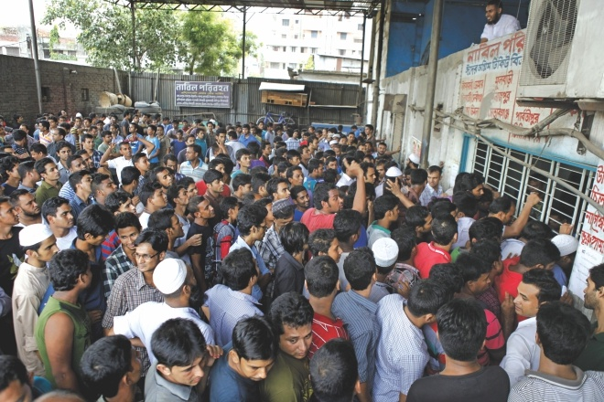
Why Ticket.com ?

Slide 4
Features-1
Bus Ticket Reservation
Show available routes and buses
Display available seats
Offer to choose preferable seats
Show costs of ticket
Offer to reserve bus ticket.
Offer to pay through mobile money transfer
Cancel ticket

Slide 5
Fetures-2
Rent A Car
Displaying available cars and their description
Offer to choose car
Showing fare of chosen car
Offer to reserve chosen car
Offer to pay through mobile money transfer
Cancelation

Slide 6
Process Model
Throw Away Prototype
Why Throw Away Prototype ?
Data oriented application
Misunderstandings are clarified
Missing functions can be identified
Poor interfaces can be refined
Missing requirements can be identified

Slide 7
Requirement Specification
Specified in the following two categories
1.Functional Requirements
2.Non-Functional Requirements

Slide 8
Functional Requirements
Details of buses such as bus schedule, routes , fare etc should be collected from bus companies.
Information of buses ,routes should be stored in DBMS .
Details of buses , routes and fare of ticket of each bus are to be maintained and can be updated regularly(Only by Administrators)
Enquiry form , bus and route information based on enquiry form ,choosing seats of selected bus form , payment form are to be maintained in separate pages .
Calculation of fare for multiple seats are to be calculated by the application alone as designated by Administrator
Details of cars such as photo of car , registration number etc for rent a car service should be displayed in a separate page

Slide 9
Non-functional Requirements
The application should be platform independent
The application should be easy to use so that all types of user can use the system
All data stored in DBMS should be accurate
Security of data should be ensured
Payment system should be secured
The interaction time between user and the application should be as less as possible
The interfaces should be user friendly

Slide 10
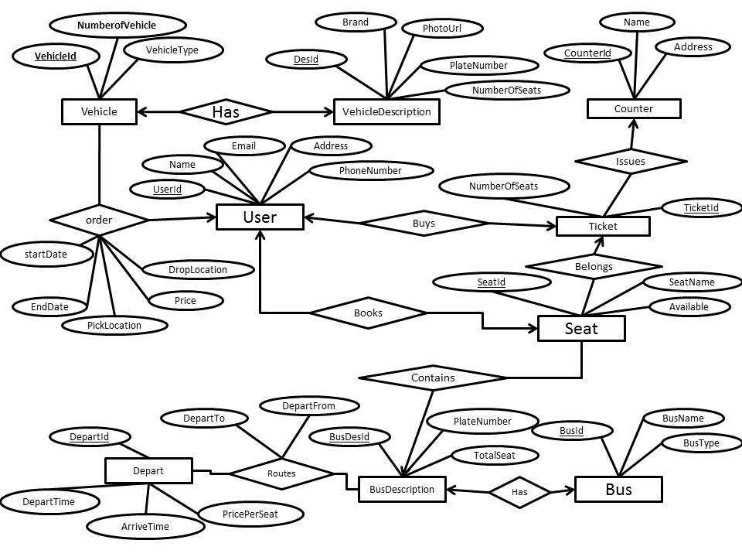
Entity Relationship Diagram

Slide 11
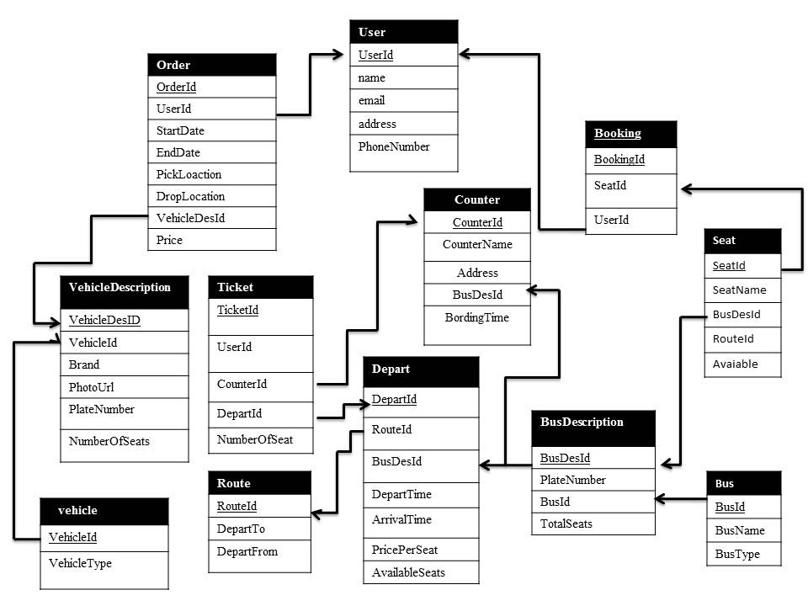
Relational Model

Slide 12
Future Plan
Covers the entire Country
Offering Train Tickets

Slide 13
THANK YOU

